Slide 1
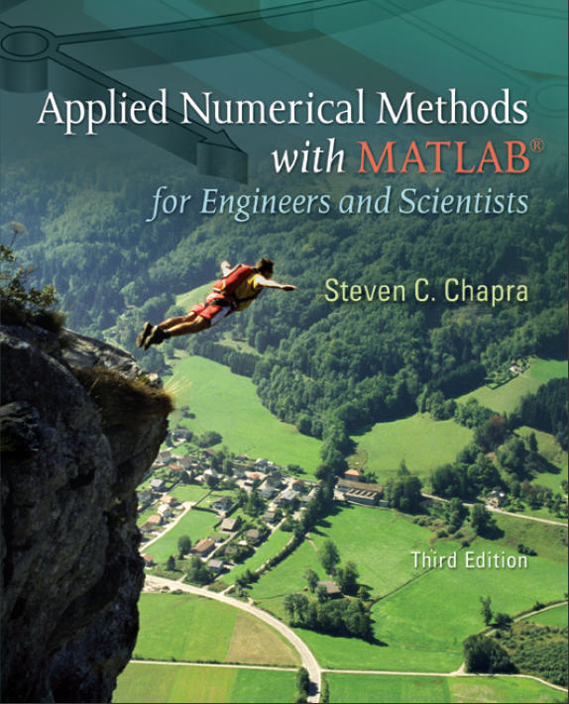
Part 3
Chapter 8
Linear Algebraic Equations and Matrices
PowerPoints organized by Dr. Michael R. Gustafson II, Duke University
All images copyright © The McGraw-Hill Companies, Inc. Permission required for reproduction or display.

Slide 2
Chapter Objectives
Understanding matrix notation.
Being able to identify the following types of matrices: identify, diagonal, symmetric, triangular, and tridiagonal.
Knowing how to perform matrix multiplication and being able to assess when it is feasible.
Knowing how to represent a system of linear equations in matrix form.
Knowing how to solve linear algebraic equations with left division and matrix inversion in MATLAB.

Slide 3
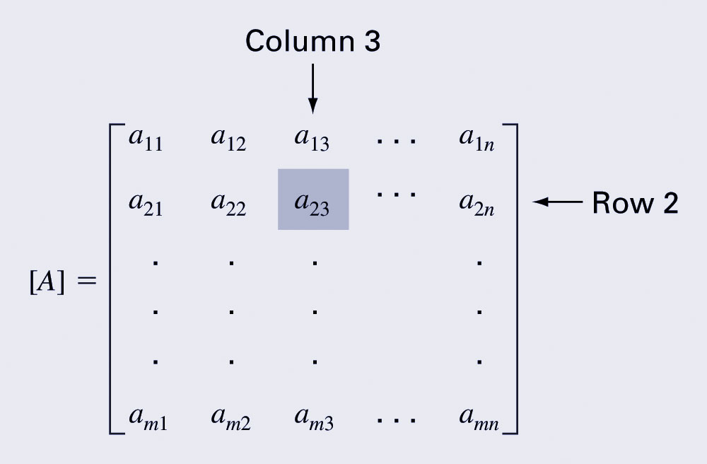
Overview
A matrix consists of a rectangular array of elements represented by a single symbol (example: [A]).
An individual entry of a matrix is an element (example: a₂₃)

Slide 4
Overview (cont)
A horizontal set of elements is called a row and a vertical set of elements is called a column.
The first subscript of an element indicates the row while the second indicates the column.
The size of a matrix is given as m rows by n columns, or simply m by n (or m x n).
1 x n matrices are row vectors.
m x 1 matrices are column vectors.

Slide 5
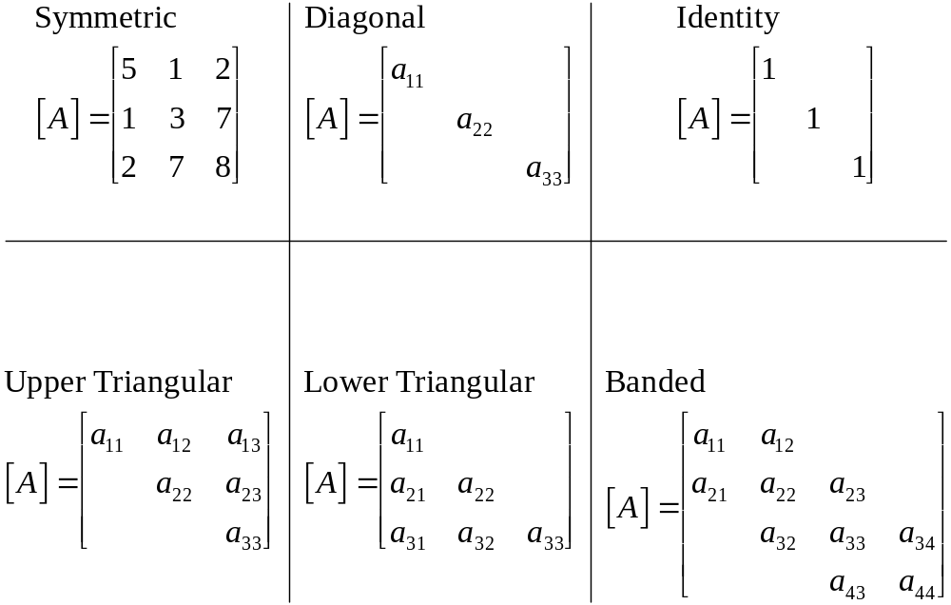
Special Matrices
Matrices where m=n are called square matrices.
There are a number of special forms of square matrices:

Slide 6
Matrix Operations
Two matrices are considered equal if and only if every element in the first matrix is equal to every corresponding element in the second. This means the two matrices must be the same size.
Matrix addition and subtraction are performed by adding or subtracting the corresponding elements. This requires that the two matrices be the same size.
Scalar matrix multiplication is performed by multiplying each element by the same scalar.

Slide 7
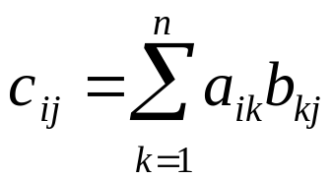
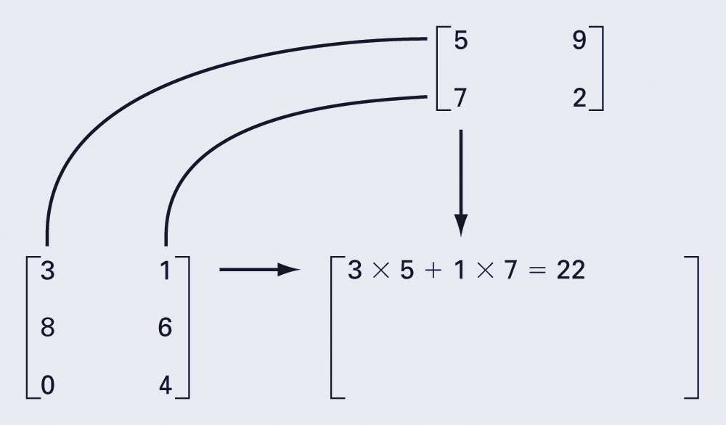
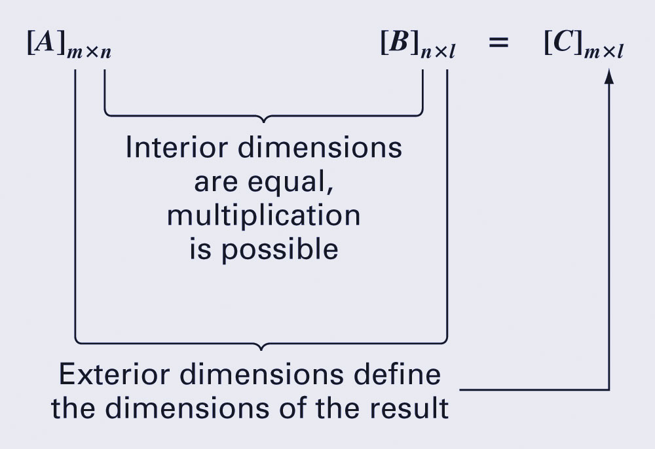
Matrix Multiplication
The elements in the matrix [C] that results from multiplying matrices [A] and [B] are calculated using:

Slide 8
Matrix Inverse and Transpose
The inverse of a square, nonsingular matrix [A] is that matrix which, when multiplied by [A], yields the identity matrix.
  [A][A]⁻¹=[A]⁻¹[A]=[I]
The transpose of a matrix involves transforming its rows into columns and its columns into rows.
  (a_{ij})^{T}=a_{ji}

Slide 9
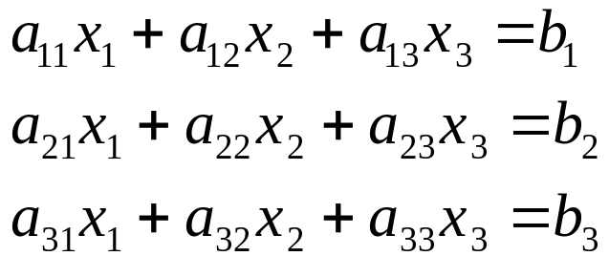
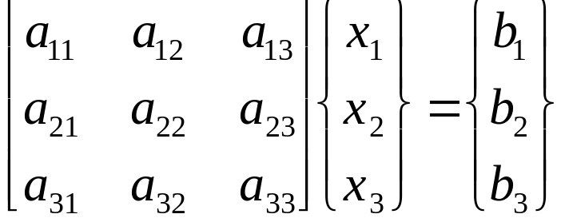
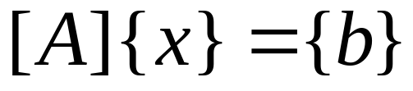
Representing Linear Algebra
Matrices provide a concise notation for representing and solving simultaneous linear equations:

Slide 10
Solving With MATLAB
MATLAB provides two direct ways to solve systems of linear algebraic equations [A]{x}={b}:
  Left-division
  x = A\b
  Matrix inversion
  x = inv(A)*b
The matrix inverse is less efficient than left-division and also only works for square, non-singular systems.

